Slide 1
GRADE-8
GEOGRAPHY
LESSON -1
RESOURCES
6/24/2020
RESOURCES/GEOGRAPHY/Mrs. sujatha/SOCIAL SCIENCE/SNS ACADEMY

Slide 2
TIME TO DO
DESIGN A POSTER FOR THE SCHOOL DISPLAY BOARDTO SPREAD AWARENESS ON THE NEED TO CONSERVEOUR NATURAL RESOURCES
6/24/2020

Slide 3
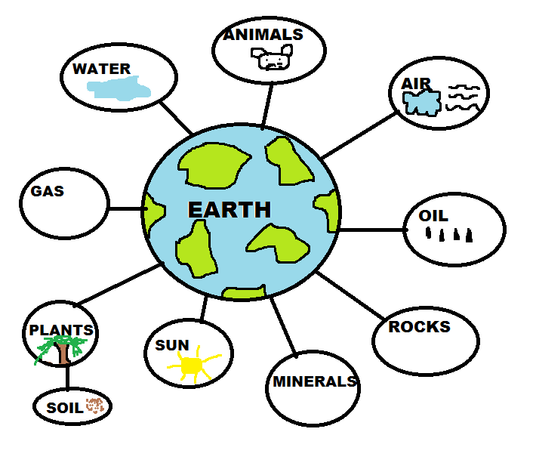
GIFT OF NATURE
Resources are gifts of nature.
It refers to all the materials available in our environment which help us to satisfy our needs.
Technology and time are the two main factors which can change substance into a resource.
6/24/2020
RESOURCES/GEOGRAPHY/Mrs. sujatha/SOCIAL SCIENCE/SNS ACADEMY

Slide 4
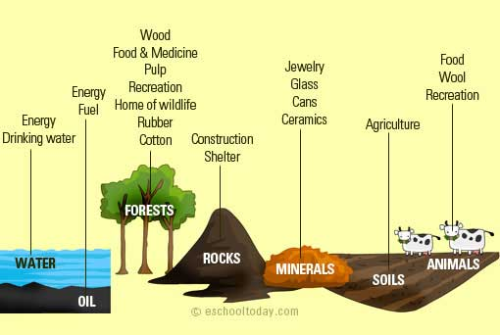
TYPES OF RESOURCES
NATURAL RESOURCES:
Natural endowments such as
Land, air,water,soil,minerals,
natural vegetation and fossil
fuels are known as natural
resources.
Some resources can be directly
used and some have to be
Processed to produce goods
Fit for consumption.
RESOURCES/GEOGRAPHY/Mrs. sujatha/SOCIAL SCIENCE/SNS ACADEMY
6/24/2020

Slide 5
NATURAL RESOURCES BASED ON ORIGIN
BIOTIC RESOURCES
ABIOTIC RESOURCES
Living resources
Plants, animals and microorganisms.
Most of the biotic resources have the Capacity to reproduce. Hence they are renewable.
Physical or non- living environment.
Land, water, air, minerals and power resources.
Their total reserve cannot be increased by human resource. Hence they are non-renewable.
RESOURCES/GEOGRAPHY/Mrs. sujatha/SOCIAL SCIENCE/SNS ACADEMY
6/24/2020

Slide 6
ON THE BASIS OF DEVELOPMENT
Potential resources Actual/developed resources
Total availability is not known Total quantity and quality
at present but can be used in future are known at present
Eg: Water falls. Eg: Reserve of coal and
petroleum.
RESOURCES/GEOGRAPHY/Mrs. sujatha/SOCIAL SCIENCE/SNS ACADEMY
6/24/2020

Slide 7
ON THE BASIS OF RENEWABILITY
Renewable resource. Non – renewable resource
These can be renewed by These are available in fixed
Reproduction, physical quantities.
mechanical or chemical process.
Eg: solar energy Eg: Minerals
wind energy fossil fuels
Inexhaustible Exhaustible
RESOURCES/GEOGRAPHY/Mrs. sujatha/SOCIAL SCIENCE/SNS ACADEMY
6/24/2020

Slide 8
ON THE BASIS OF DISTRIBUTION
Ubiquitous Localised
Found everywhere Found only at certain places
Eg: air, sunlight Eg: Gold, silver
HUMAN MADE RESOURCES
Human beings use their knowledge and skill to develop technology and convert the natural resources into useful products.
Human beings use natural resources to develop buildings, roads machinery and vehicles. These are known as human made resources.
6/24/2020
RESOURCES/GEOGRAPHY/Mrs. sujatha/SOCIAL SCIENCE/SNS ACADEMY

Slide 9
HUMAN RESOURCES
The greatest resource of the earth is human beings.
Knowledge skill and technology
make the best of natural resources
Discover exploit develop and convert available or potential resources into useful products or wealth.
6/24/2020
RESOURCES/GEOGRAPHY/Mrs. sujatha/SOCIAL SCIENCE/SNS ACADEMY

Slide 10
CONSERVATION OF RESOURCES
6/24/2020
6/24/2020
RESOURCES/GEOGRAPHY/Mrs. sujatha/SOCIAL SCIENCE/SNS ACADEMY

Slide 11
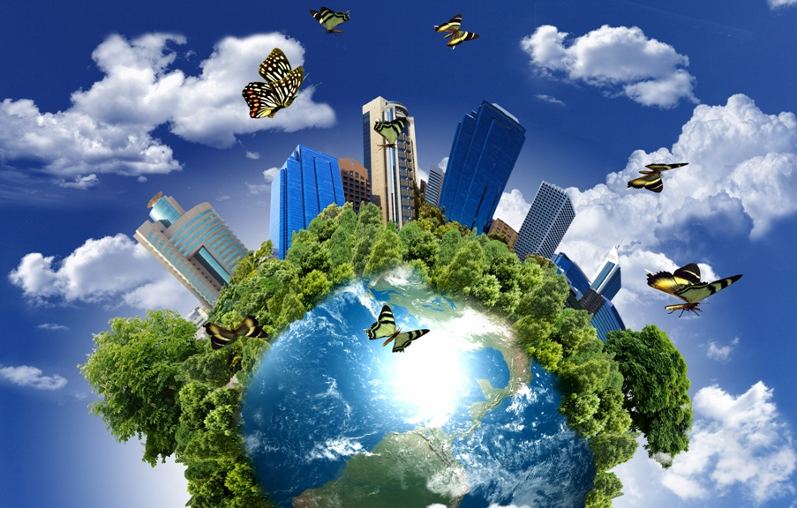
SUSTAINABLE DEVELOPMENT OF NATURAL RESOURCES
When we use natural resources properly for today’s need and also conserve them for the future generation is called sustainable development.
RESOURCES/GEOGRAPHY/Mrs. sujatha/SOCIAL SCIENCE/SNS ACADEMY
6/24/2020

Slide 12
QUESTIONS:
Can a gift of nature become a resource in future?
Why do you think the use of resources should be sustainable?

Slide 13
REFERENCES
rsgr.in/sg0145
Rsgr.in/sg0147
Thank you.

